Slide 1

Pre placement PROJECT ON ​ automobile data
analysis using sql, python and tableau ​
Mentored by – Jaya Pandey
Presented by – Pushkar Hedau

Slide 2
DESCRIPTION OF THE AUTOMOBILE DATASET
The automobile dataset contains 9 columns namely 'name', 'mpg', 'cylinders', 'displacement', 'horsepower', 'weight', 'acceleration', 'model_year', 'origin'.
The dataset contains 398 rows and 9 columns and doesnot contain any null value.
Objective of the analysis
The objective of this analysis project is to gain insights into automobile characteristics and performance. It involves identifying patterns, comparing attributes, categorizing cars, providing decision-making insights, and utilizing data visualizations to effectively communicate findings.

Slide 3
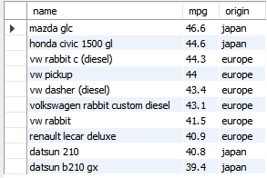
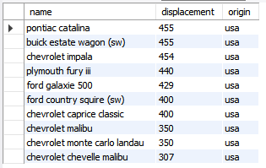
-- Task-1) The top 10 automobiles with the highest fuel efficiency (MPG).
Interpretation--
The top 10 cars consists of 4 cars from japan and 6 cars from europe region and no cars from usa region on the basis of fuel efficiency.
-- Task-2) Find the top 10 automobile with the maximum displacement (engine capacity)
Interpretation--
The top 10 cars with maximum engine capacity are all from usa region and the maximum egine capacity is 455 cc of pontiac catalna car.

Slide 4

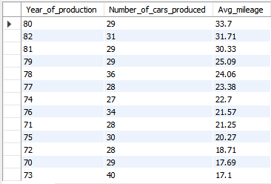
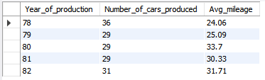
-- Task-3) Group the automobiles by origin country and find the avg fuel efficiency (MPG)
Interpretation--
The usa region has the maximum number of cars ie. 249 and have avg mileage of 20.08 miles per gallon.
-- Task-4) Number of cars produced in each year?
Task 4.2) Number of cars produced in each year having mpg greater than average mpg
Interpretation--
Highest numbr of cars produced in year 1973 ie. 40 and highest avg_mileage is 33.7 miles per gallon for the year 1980

Slide 5
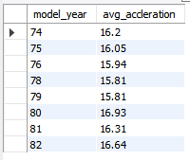
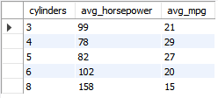
-- Task-5) Calculate the average acceleration for automobiles produced in different decades.
-- Task-6) Calculate the average horsepower for each number of cylinders in the engine.

Slide 6
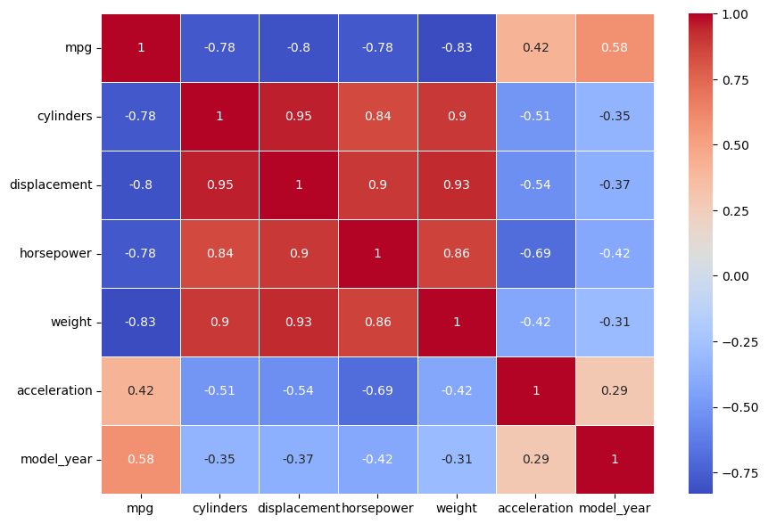
Analysis using python of automobile dataset
Interpretation ---
On the basis of the het map
There is high correlation between mileage and acceleration .
The is high correlation of number of cylinders and displacement , horsepower and weight.
Acceleration has a negative correlation with number of cylinders , displacement, horsepower and weight.

Slide 7
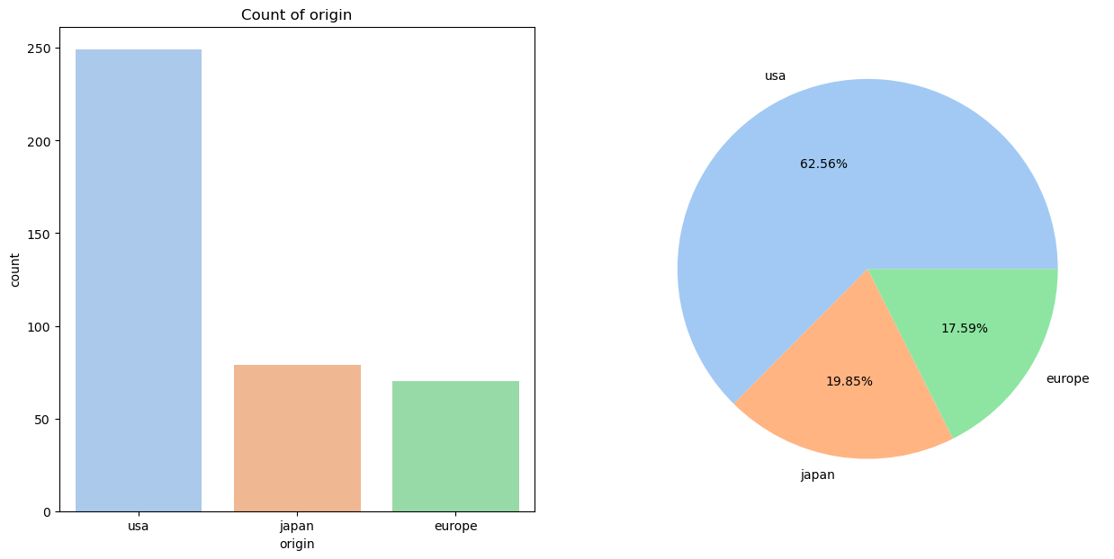
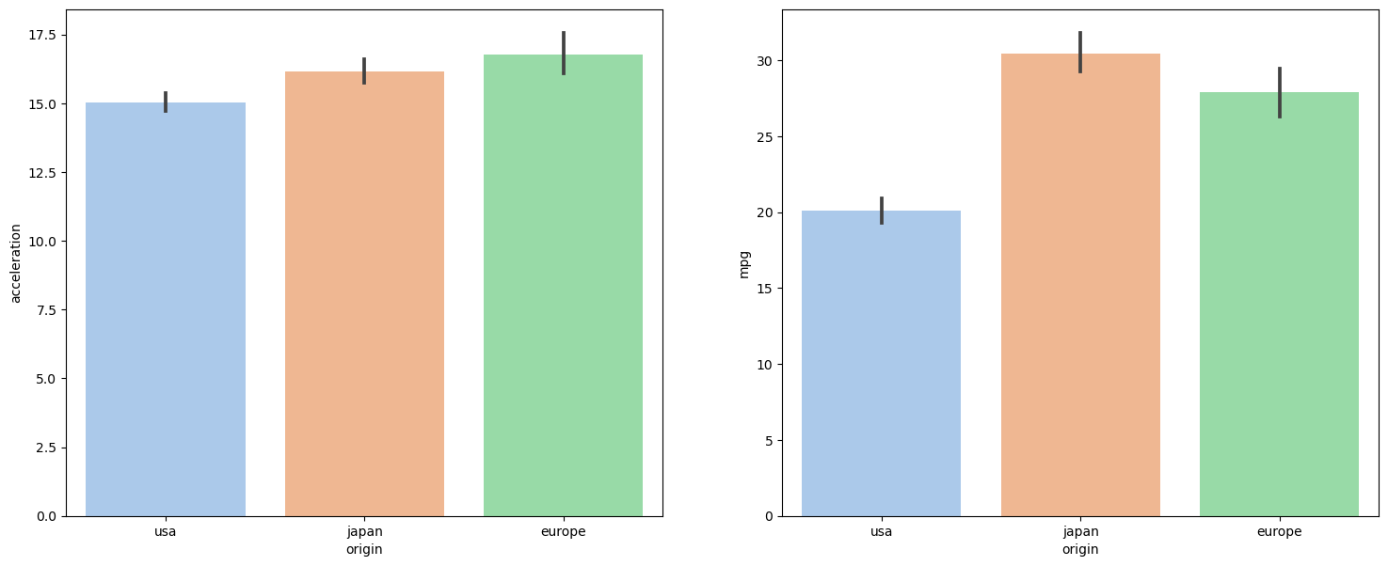
Bivariate analysis of country of origin and the number of cars produced from each country
Interpretation ---
U.S.A. has produced the largest number of cars as 249 number and europe has produced the least ie. 70 number.
Bivariate analysis of country of origin and the avg acceleration and avg mileage
Interpretation ---
On the basis of avg acceleration cars that produced from europe has highest acceleration .
On the basis of avg mileage, car produced from japan has the highest fuel efficeiency and usa as the least fuel efficient cars

Slide 8
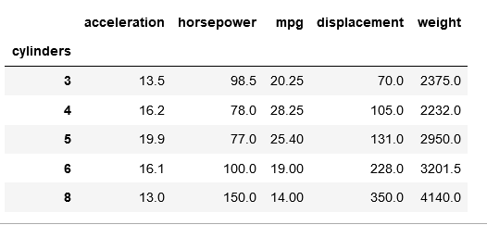
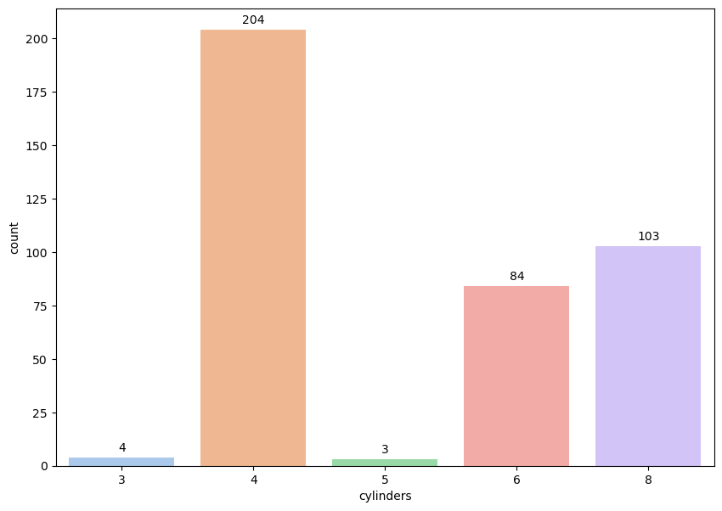
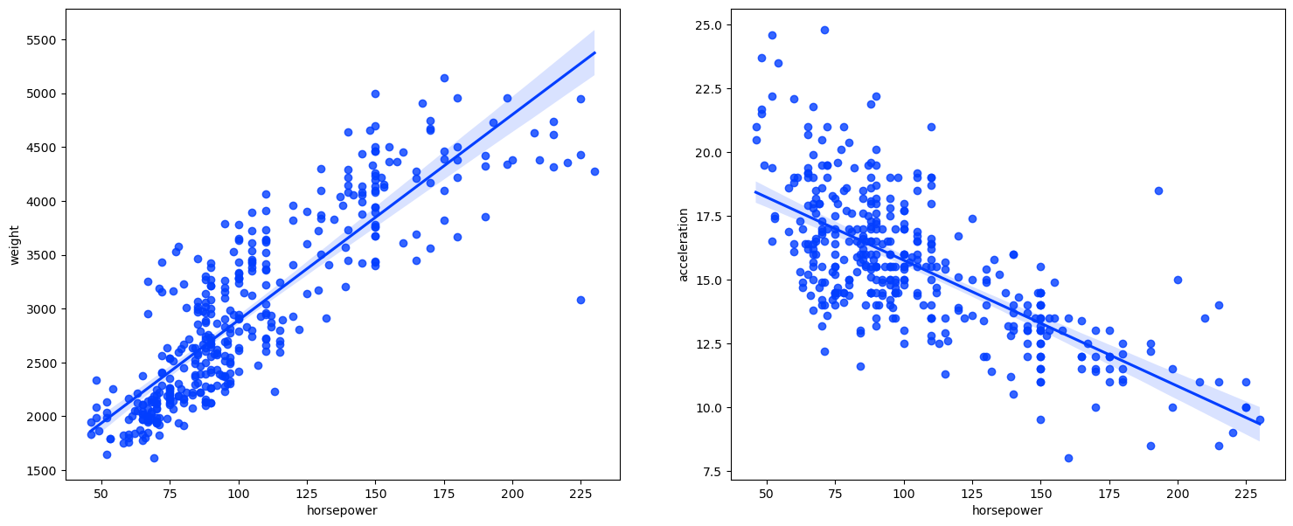
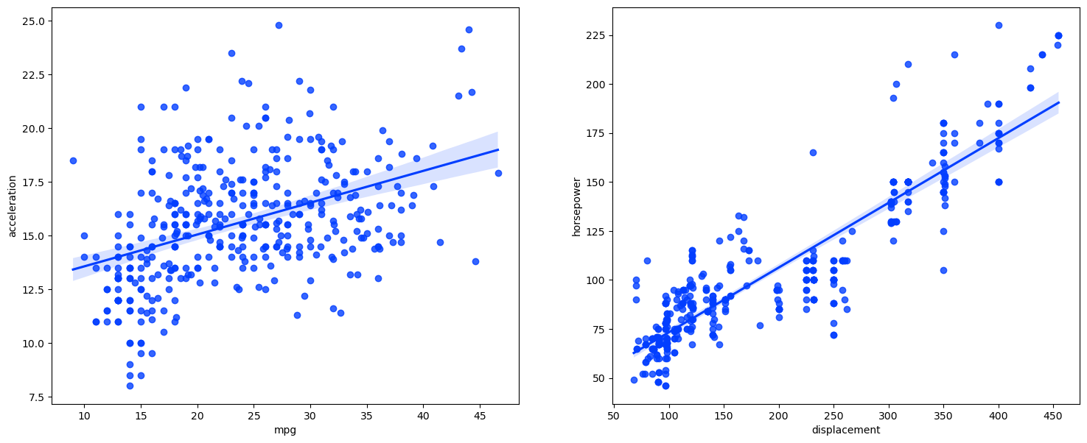
Interpretation ---
Cars that have 4 cylinder is the highest then 8 cylinder cars and 6 cylinder cars have been produced.
With increase in the number of cylinder the horsepower , weight, displacement increases and mileage, acceleration decreases .

Slide 9
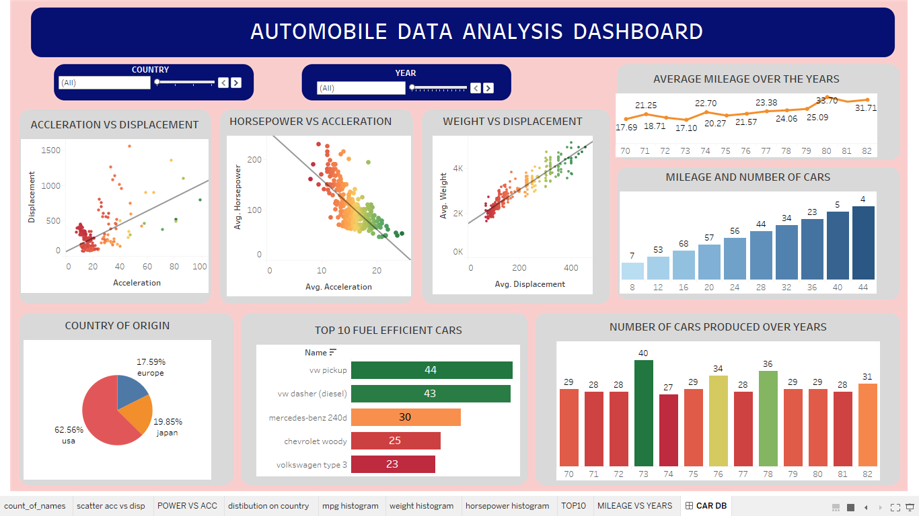

Slide 10
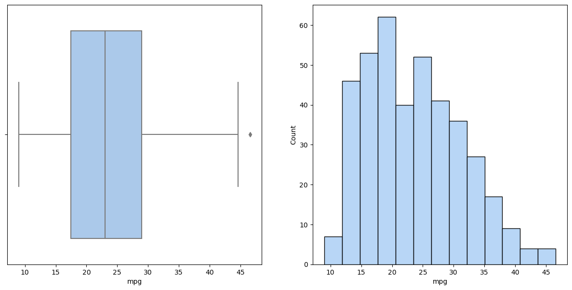
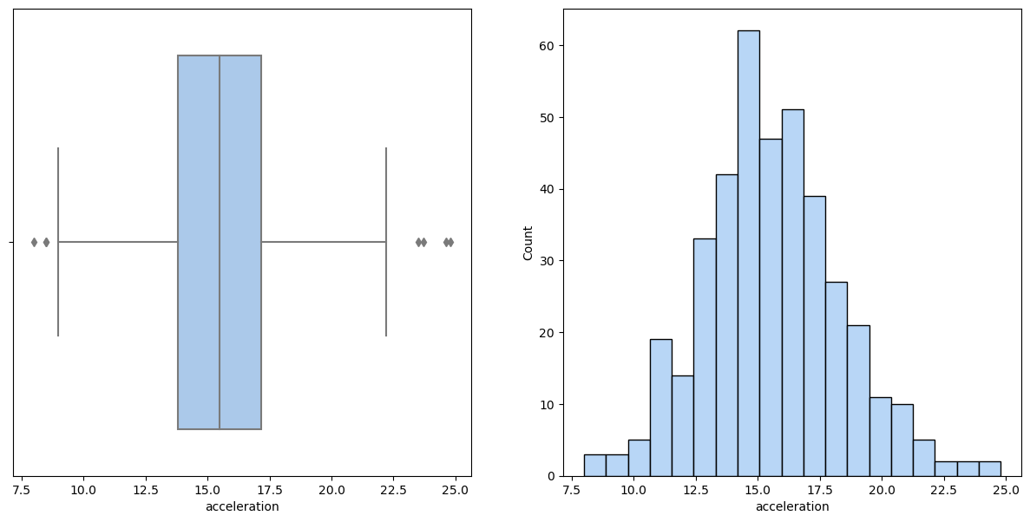
Conclusion --
There were 9 parameters in the automobile dataset and I have taken all of them in consideration .
There were 3 region where the cars were produced ie. USA, EUROPE, JAPAN .
Majority of cars were produced in USA and least produed in japan.
Cars that were produced in USA were high in terms of weight, number of cylinders, displacement and horsepower . The cars produced in usa are powerful can have high speed but are very low fuel efficient and there acceleration is also less.
Cars produced from japan and europe are more fuel efficient , they have a better mileage and acceleration and are low in terms of weight , power and displacement.
Cars produced in japan and europe are suitable of middle class people who need a more fuel efficient car .

Slide 11
THANK YOU

